Slide 1


M KUMARASAMY COLLEGE OF ENGINEERING KARUR department of mechanical engineering

Slide 2
FABRICATION OF GENEVA MECHANISM USED BELT DRIVE IN CONVEYOR BATCH MEMBERS N.JOHN FERNANDEZ 927621BME309 R.KRISHNA 927621BME314 GUIDE NAME Mr.R.MANIKANDAN

Slide 3
ABSTRACT
The Geneva drive is a gear mechanism that translates a continuous rotation into an intermittent rotary motion. The rotating drive wheel has a pin that reaches into a slot of the driven wheel advancing it by one step. The drive wheel also has a raised circular blocking disc that locks the driven wheel in position between steps.

Slide 4
INTRODUCTION
One application of the Geneva drive is in movie projectors the film does not run continuously through the projector. Instead, the film is advanced frame by frame, each frame standing still in front of the lens for 1/24 of a second (and being exposed twice in that time, resulting in a frequency of 48 Hz). This intermittent motion is achieved using a Geneva drive. Modern film projectors may also use an electronically controlled indexing mechanism or stepper motor, which allows for fast-forwarding the film.

Slide 5
The first uses of the Geneva drive in film projectors go back to 1896 to the projectors of Oskar Messter and Max Gliewe and the Teatrograph of Robert William Paul. Previous projectors, including Thomas Armat’s projector, marketed by Edison as the Vitascope, had used a "beater mechanism", invented by Georges Demenÿ in 1893, to achieve intermittent film transport.

Slide 6
LITERATURE REVIEW
Mr M. V. Ingalkar , Mr A. R. Sonekar , Mr Y. D. Bansod
Design, Cad Modeling & Fabrication of Geneva Operated Roller Conveyor
The Geneva drive is a gear mechanism that translates a continuous rotation into an intermittent rotary motion. The rotating drive wheel has a pin that reaches into a slot of the driven wheel advancing it by one step. In this project we Determination of angular velocity and acceleration of Geneva wheel and also To determine the transport time of the object to cover the entire conveyor.

Slide 7
WORKING PRINCIPLE
This model of project rotates the conveyor roller, it is not only continuous rotation, it is rotate intermittent time based system, which is using Geneva wheel mechanism. The Geneva wheel attached for direct conveyor, that is connecting on guide disc on D.C Motor drive.
The D.C motor continuously drive the guide disc but it is containing for guide pin, which is intermittent Geneva wheel it is time based drive that system.

Slide 8
This overall system any product of material going to the conveyor one station to another station it is particular time period it is move, whereas we have to design the Geneva wheel our particular time based on conveyor system.

Slide 9
PARTS
DC MOTOR
BATTERY
SHAFT
FRAME
BEARING
CONVEYOR BELT
CONVEYOR ROLLER
CHAIN DRIVE
GENEVA MECHANISM

Slide 10
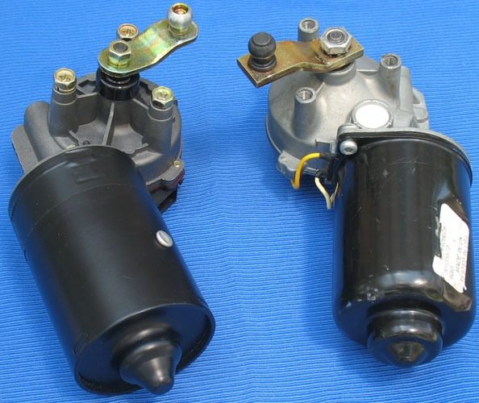
DC MOTOR
The electrical motor is an instrument, which converts electrical energy into mechanical energy. According to faraday’s law of Electromagnetic induction, when a current carrying conductor is placed in a magnetic field, it experiences a mechanical force whose direction is given by Fleming’s left hand rule.
DC Motor capacity : 12V
Un loading : 130rpm
Loading : 90rpm

Slide 11

BATTERY
Battery Specification:
Capacity: 12V and 7.3 Ah
Rechargeable battery one
Battery type: Lead – acid battery
Charge capacity: 4.2 hour loading condition
Charging time: 3 hour

Slide 12
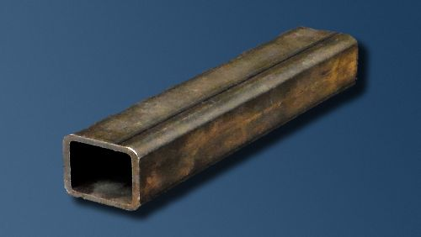
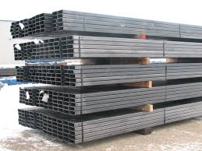
FRAME
Material: Mild steel

Slide 13
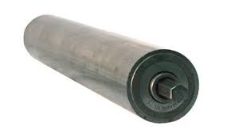
CONVEYOR ROLLER
Material: Mild steel.
Outer diameter: 35mm.
Inner diameter: 15mm

Slide 14
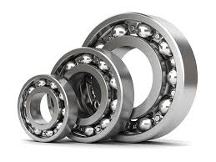
DESIGN OF BALL BEARING
Bearing No. 6202 (Data book page.no 4.13)
Outer Diameter of Bearing (D) = 35 mm
Thickness of Bearing (B) = 12 mm
Inner Diameter of the Bearing (d) = 15 mm
r₁ = Corner radii on shaft and housing
r₁ = 1(From design data book)
Maximum Speed = 14,000 rpm (From design data book)
Mean Diameter (d_{m}) = (D + d) / 2
= (35 + 15) / 2
d_{m} = 25 mm

Slide 15
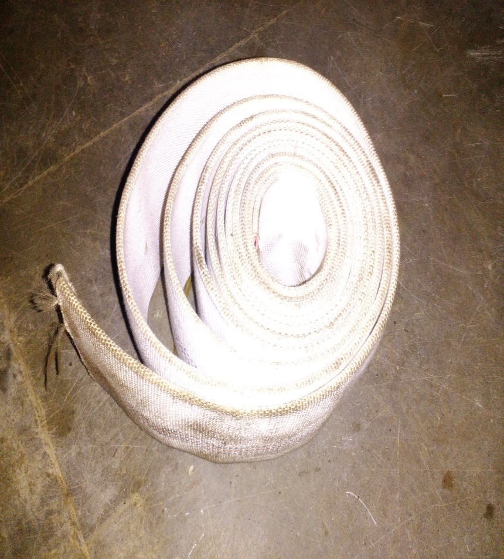
CONVEYOR BELT
Material: Cloth
Width: 25cm

Slide 16
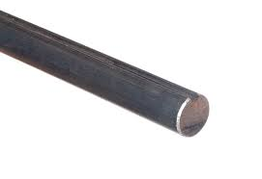
SHAFT
Shaft diameter: 12mm
Material: mild steel

Slide 17
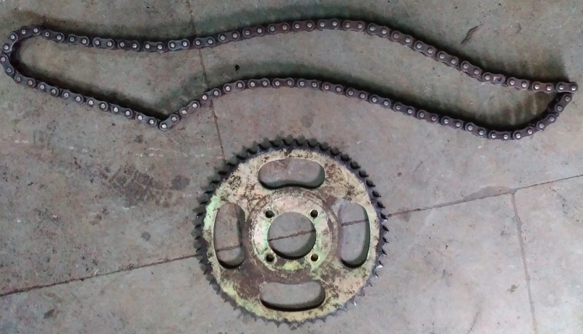
CHAIN DRIVE

Slide 18
MATERIAL | HIGH CARBON STEEL
PITCH | 12.7MM
WIDTH | 30MM
TEETH | 45
BALLS | HIGH CARBON HIGH CHROMIUM STEEL BALLS

Slide 19
GENEVA MECHANISM
The Geneva drive or Maltese cross is a gear mechanism that translates a continuous rotation into an intermittent rotary motion. The rotating drive wheel has a pin that reaches into a slot of the driven wheel advancing it by one step. The drive wheel also has a raised circular blocking disc that locks the driven wheel in position between steps.

Slide 20
MERITS
Low cost.
Less human effort.

Slide 21
APPLICATION
It is used for industrial conveyor and used for small industries.
It is used for packing industries and bottle cleaning industries.

Slide 22
MATERIAL USED
S.No | DESCRIPTION | QTY | MATERIAL
1. | DC MOTOR | 1 | ELECTRICAL
2. | BATTERY | 1 | ELECTRICAL
3. | BEARING | 8 | STAINLESS STEEL
4. | SHAFT | 1 | MILD STEEL
5. | CONVEYOR BELT | 1 | MILD STEEL
6. | FRAME | 1 | MILD STEEL
7. | CHAIN DRIVE | 1 | STAINLESS STEEL
8. | GENEVA MECHANISM | 1 | MILD STEEL
9. | CONVEYOR ROLLER | 2 | MILD STEEL

Slide 23
COST ESTIMATION
SL.NO | DESCRIPTION | COST Rs
1. | DC MOTOR | 800
2. | BATTERY | 800
3. | BEARING | 800
4. | SHAFT | 800
5. | CONVEYOR BELT,ROLLER | 1000
6. | FRAME | 1000
7. | CHAIN DRIVE | 700
8. | GENEVA MECHANISM | 600
9. | TOTAL | 6500

Slide 24
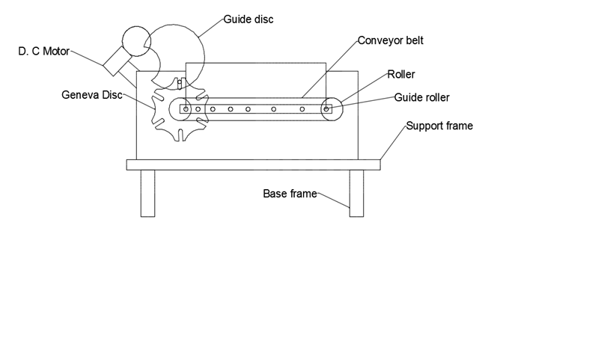
BLOCK DIAGRAM

Slide 25


